Slide 1

AstroSage Call Center Dashboard & Analysis
Performance Insights and Strategic Recommendations
Prepared by: Manoj R k | B.Tech CSE | 2025

Slide 2
Data overview
createdAT: timestamp when the session was created. used to analyze trends over time.
consultation type: type of session (e.g., chat or call). helps identify usage patterns.
guruname: name of the astrologer who handled the session. used to evaluate agent performance.
chatstatus / callstatus: indicates whether the session was completed, failed, or incomplete.
user / uid: unique id for each customer. used to track repeat users.
callsid: unique identifier for each call. helps in counting total calls.
amount: amount paid by the user for the session. important for revenue analysis.
astrologers earnings: amount earned by the astrologer. used to compare earnings vs. performance.
net amount: company’s profit from the session after deductions.
rating: user satisfaction score based on the session. crucial for quality analysis.
region: user’s location. helps in regional performance or targeting.

Slide 3
Problem Statement
AstroSage has received a 1 crore investment and aims to optimize its call center operations. The goal is to determine how to allocate this investment to maximize operational efficiency, customer satisfaction, and profitability. The analysis will consider historical call data, performance metrics, and market trends to make informed decisions.

Slide 4
Objectives
Clean and prepare the raw data
Handle missing values, remove duplicates, and standardize formats for accurate analysis.
Identify user behavior patterns
Analyze repeat callers and their impact on total call volume and satisfaction.
Evaluate Guru performance
Determine which Gurus have the highest/lowest satisfaction ratings and workload balance.
Measure customer satisfaction
Understand how factors like call duration, consultation type, and region affect ratings.
Track financial metrics
Calculate total revenue and evaluate performance by consultation type (Call vs Chat).
Visualize data through a dashboard
Build a Google Sheets dashboard with pivot charts, KPI cards, and slicers for interactive insights.
Support strategic decision-making
Provide actionable recommendations to improve training, workload distribution, and user retention.

Slide 5
Methodology
Data Cleaning: Removed duplicates, filled blanks (chatSeconds, rating, netAmount),
replaced missing text with “Unknown”.
Data Preparation: Standardized formats, created date/time columns (Created_Date, Month, etc.).
Pivot Analysis: Used pivot tables to analyze call volume, guru ratings,
consultation types, and repeat callers.
Formulas Applied: COUNTIF, AVERAGEIF, IF, ISBLANK, TEXT for date/time formatting.
Visualization: Created charts (line, pie, bar), added slicers and KPI cards in Google Sheets dashboard.
Business Questions: Answered objective & subjective questions using insights from data.
Recommendations: Based on trends in user behavior, satisfaction, and revenue impact.

Slide 6
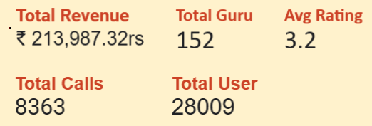
kPI’s [Key Performance metrics]
Total Revenus
Total Guru
Number of Calls
Total User
Avg.Rating
.
ANALYSIS
There are Total 28009 Users
The Net Revenue of the Industry is 213987.32
The Total Number of 8363 calls have been done.
Total Guru 152
Avg Rating is 3.2
.

Slide 7
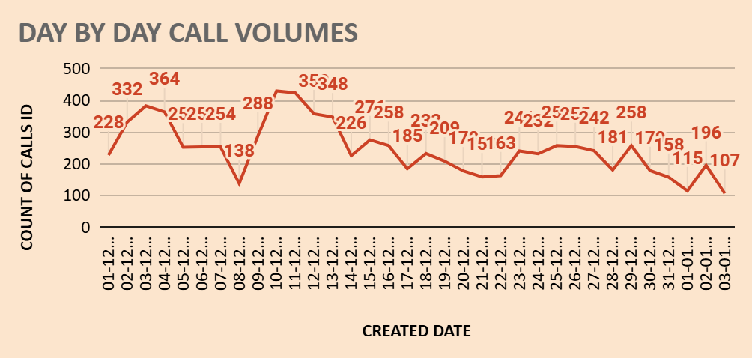
ANALYSIS
The average daily call volume is 245.97
On 10/12/23 there was highest call volume i.e 430.
On 03/01/2024 there was lowest call volume i.e. 107.
December : Highest call volume.
January : Lowest call volume.
Call centre receive approx. 250 calls per day but only 40.63% of calls gets complete in total from astrologer side.
Suggestion –
There is a need of hiring new skilled agents and freelancers to manage the workload of existing agents.

Slide 8
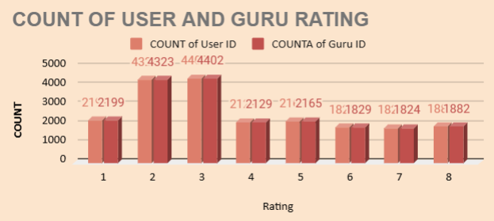
ANALYSIS
Satisfied user (Rating-5,6,7,8) =
37.10%
Unsatisfied user (Rating-0,1,2,3,4) = 62.89%
Out of 8339 calls only 3542 calls are getting completed, which is 40.63%.
The remaining 59.37% of users are not getting the service despite of booking the call session.
Suggestion –
Invest in training programs for the agents, by which they will get training to give better service to the users and manage time properly.

Slide 9
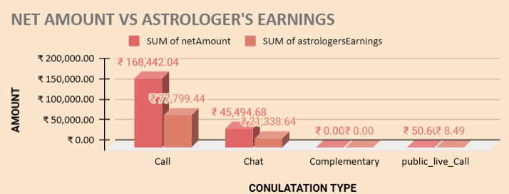
ANALYSIS
The 78.69% of the total net income for the company comes from Call service only.
And the 78.44% of the total income for the astrologer comes from Call service.
Total revenue = 213987.32 rs.
Correlation between net income and astrologer earning is 0.997,which suggests a very strong positive linear relationship between two variables.
Suggestion -
So if the call service is a key revenue driver, investing in training programs would be a strategic move to sustain and enhance that success.

Slide 10
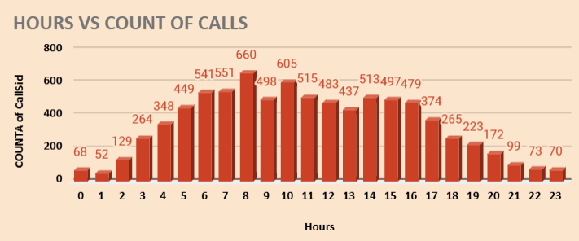
ANALYSIS
Around 8.00 am the traffic of the callers are very high.
Around 01.00 am at night the traffic is very low.
Approx 660 users calls around 8.00 am.
There are only 152 agents.
Suggestion-
Hire part time or freelancer agents , this reserve agents will balance the workload without increasing permanent cost.
Shift optimization- Optimizing more agents shifts to peak periods accordingly. Ensure that more agents are scheduled during high – traffics time.

Slide 11
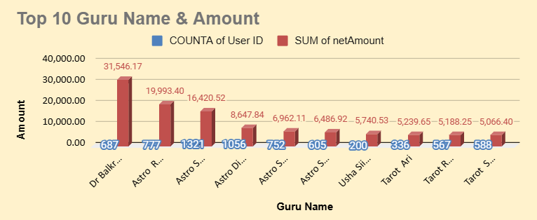
ANALYSIS
7256 times Guru gets the rating of 0.
Satisfied user (Rating-5,6,7,8) = 37.10%
Unsatisfied user (Rating-0,1,2,3,4) = 62.89%
Suggestion-
Company should run training program which include-
Call Handling Techniques
Enhancing Skills
Cross-Selling:
Adaptation to Growth

Slide 12
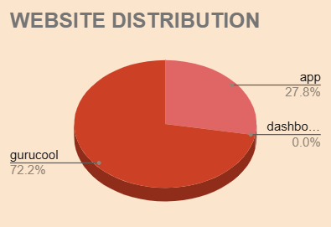
ANALYSIS
72 % of users use Gurucool website.(Source of consultancy)
28 % of users use App. (Source of consultancy)
Highest sales generated by App i.e. 125267.38
Suggestions –
Gurucool is only one platform which provide the service of the Chat to the users.
But the average rating of the Gurucool is 2.72, which is the clear indicator of unsatisfied users.
So it is very necessary to improve technology and provide satisfaction to the users

Slide 13
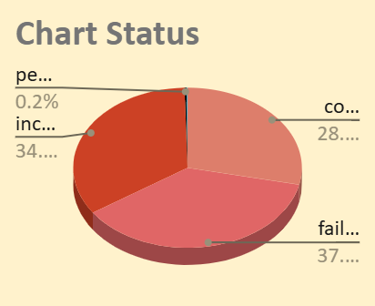
ANALYSIS
28.4% of chats get completed between agents and users.
34% of chat remain incomplete.
While 37% of chat get failed.
69.62% of total users use chat service and gurucool is only website which provide chat service.
Suggestion-
Investing in gurucool technology upgrades will help to improve the overall experience and will help to increase the retention rate of the users. And increase the user satisfaction as it is only 2.71 for chat service.

Slide 14
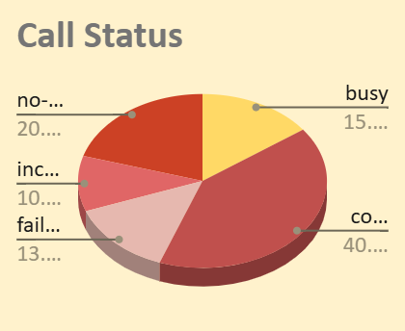
ANALYSIS
Only 40% users call get completed.
20% of user didn’t get any answer.
While 13% users call get failed.
And 10% of users call remain incomplete.
Suggestions-
Hire part time or freelancer agents, this reserve agents will balance the workload without increasing permanent cost.
Shift optimization: Optimizing more agents shifts to peak periods accordingly. Ensure that more agents are scheduled during high – traffics time.

Slide 15
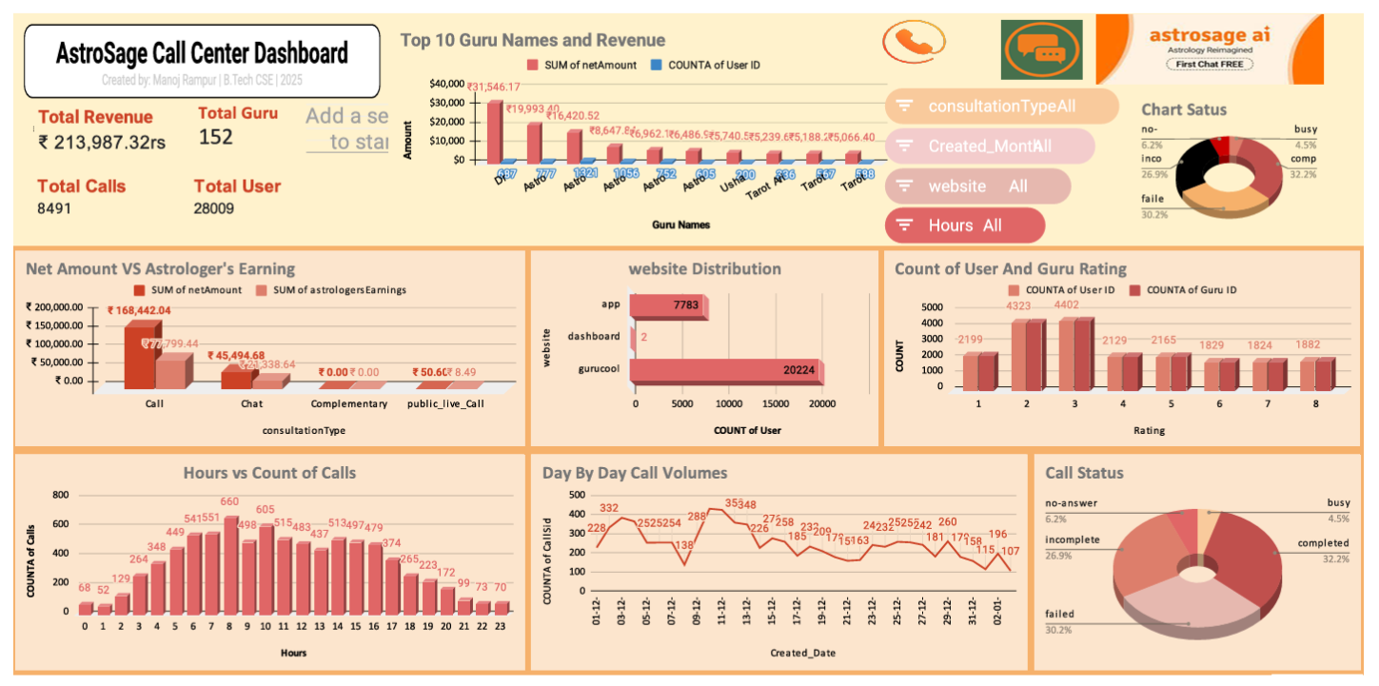
DASHBOARD

Slide 16
SUGGESTIONS
AFTER ANALYZING ALL THESE INSIGHTS I RECOMMEND THE COMPANY TO INVEST 1 CRORE IN THREE PHASES:
1. Technology Upgrade – ₹40 lakhs (40%)
As Exotel is the only cloud phone system with which company work, fund should be invested in building another cloud phone system to manage the burden
Buy new high-tech equipment.
Upgrade the chat platform (UI/UX).
Introduce AI chatbots for instant query resolution.
Improve backend performance to reduce lag or crashes.
2. Agent Training Program – ₹25 lakhs (25%)
Conduct monthly training on soft skills, upselling, and technical handling.
Use analytics to identify underperforming agents and offer targeted coaching.
3. Support Infrastructure, Data Security & Customer Care Tools – ₹35 Lakhs (35%)
Hire freelance/part-time agents to manage peak hours and reduce customer wait time.
Invest in infrastructure and data protection (cloud backups, system stability).
Set up automated feedback tools (post-call surveys, follow-ups) to improve customer support and satisfaction.

Slide 17
CONCLUSION
To address the problem statement, i conducted a comprehensive analysis by cleaning the data, creating pivot tables, charts, and developing an interactive dashboard. these insights have been instrumental in drawing meaningful conclusions and supporting data-driven decisions. this project offered a valuable opportunity to apply and enhance my excel skills, and i thoroughly enjoyed working on it.”

Slide 18

THANK YOU.....

